Slide 1

DENTAL OFFICE MODEL
TANAYA DESHMUKH 002108586
SHWETA WAKALE 001518127
RAMYA KANGURI 002133068
HARSHAVARDHANI RACHAGIRI
002105042

Slide 2
OVERVIEW
This project deals with the designing database for a dentist office and implementing its functionality in a web application
The model also gives a brief explanation of what data needs to be stored along with its attributes and datatypes for the developers
The ER model depicts the relations between the major subject areas along with the attributes. It covers the main subject areas like the Patients, Dentists, Appointments, Payments etc. along with the essentials associated with them are stored here

Slide 3
AUDIENCE
Database developers
Stakeholders
Business Developers
Database Engineers

Slide 4
TECHNOLOGIES USED
Front End: HTML, CSS, WordPress
Middle- Ware: PHP
Database: MySQL PhpMyAdmin
Tools: SQL Server Management Studio

Slide 5
MODEL UNIQUE FEATURES
Treatment Steps to determine what is the current treatment the patient is undergoing.
Treatment Final step attribute for the dentist and patient to determine the final step for the particular treatment.
Problem Catalog for identifying the problem on a tooth.
Present mouth condition to store attributes like plaque, stains etc for the dentist to determine the mouth condition of the patient
Present Number of teeth to determine which tooth are present or missing for a particular patient

Slide 6
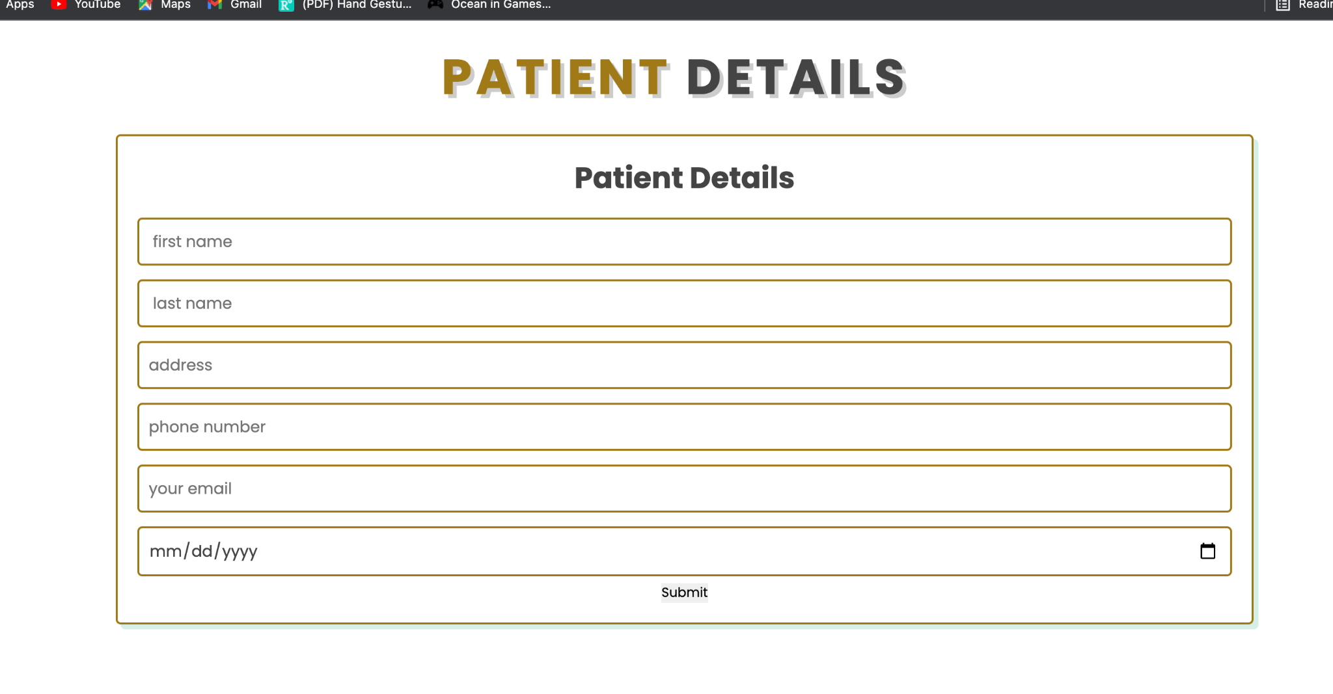
FRONT-END IMPLEMENTATION : HOMEPAGE

Slide 7
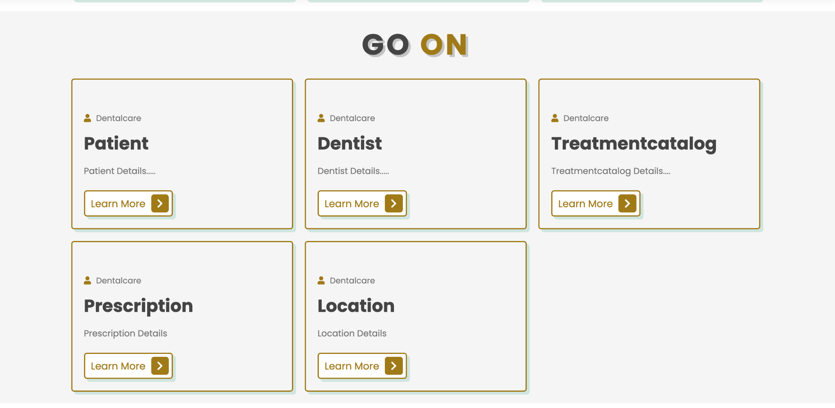
FRONT END

Slide 8
FUTURE SCOPE
Separate Entities for Login of Patient and Dentist.
A secured payment gateway and secured tables to store sensitive information.
Login for staff and supply manager at dentist office to keep a track of the supplies and equipment.
Functionality for the Patient to view their prescriptions.
Functionalities to auto-update the availability of room, equipment & dentist after an appointment is cancelled.
Functionalities to communicate invoices through multiple insurance companies.

Slide 9
THANK YOU

